Slide 1
Word Embedding
龚志远
2018年9月25日

Slide 2
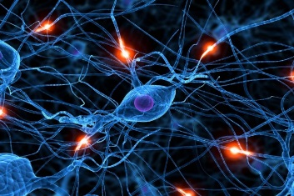

Word Embedding
利用Word Embedding将一个单词转换成固定长度的向量表示，从而便于进行数学处理
无监督学习
Word Embedding
tree
flower
dog
rabbit
run
jump
cat

Slide 3
1-of-N Encoding
Word Embedding
apple = [ 1 0 0 0 0]
dog
bag = [ 0 1 0 0 0]
rabbit
run
cat = [ 0 0 1 0 0]
jump
cat
dog = [ 0 0 0 1 0]
tree
flower
elephant = [ 0 0 0 0 1]
Word Class
class 1
Class 2
Class 3
dog
ran
flower
cat
jumped
bird
walk
tree
apple
Notes:
1-hot缺点：长度太大，关联程度体现不出来

Slide 4
Word Embedding
利用大量文档学习word的内在含义，word间的潜在联系
胡锦涛，习近平在某些方面相近
胡锦涛 就任国家主席
习近平 就任国家主席
Notes:
词的语义由其上下文决定

Slide 5
How to exploit the context?
Count based
If two words w_{i} and w_{j} frequently co-occur, V(w_{i}) and V(w_{j}) would be close to each other
E.g. Glove Vector: http://nlp.stanford.edu/projects/glove/
Perdition based
V(w_{i}) . V(w_{j})
N_{i,j}
Inner product
Number of times w_{i} and w_{j} in the same document
Notes:
统计语言模型把语言（词的序列）看作一个随机事件，并赋予相应的概率来描述其属于某种语言集合的可能性。给定一个词汇集合 V，对于一个由 V 中的词构成的序列S = ⟨w1, · · · , wT ⟩ ∈ Vn，统计语言模型赋予这个序列一个概率P(S)，来衡量S 符合自然语言的语法和语义规则的置信度

Slide 6
Prediction-based – Training
夏天
Neural
Network
很
Collect data:
天气
夏天 天气 很 炎热 晒 …
天天 打雷 下雨 …
人类 生活 的…
………
天气
Neural
Network
炎热
很
Minimizing cross entropy
很
Neural
Network
晒
炎热
Notes:
What can it do? Application?

Slide 7
Prediction-based – Language Modeling
P(“wreck a nice beach”)
=P(wreck|START)P(a|wreck)P(nice|a)P(beach|nice)
P(b|a): the probability of NN predicting the next word.
P(next word is “wreck”)
P(next word is “a”)
P(next word is “nice”)
P(next word is “beach”)
Neural
Network
Neural
Network
Neural
Network
Neural
Network
1-of-N encoding of “START”
1-of-N encoding of “wreck”
1-of-N encoding of “a”
1-of-N encoding of “nice”
Notes:
假设在一段文本中，第N个词的出现只与前面n-1个词相关，而与其他任何词都不相关

Slide 8
Prediction-based
w_{i}
…… w_{i-2} w_{i-1} ___
0
z₁
1-of-N encoding
of the word w_{i-1}
1
z₂
The probability for each word as the next word w_{i}
0
……
……
…
……
Take out the input of the neurons in the first layer
z₂
tree
flower
Use it to represent a word w
dog
rabbit
run
jump
cat
Word vector, word embedding feature: V(w)
z₁
Notes:
Note that we only consider one input word, we only consider wi-1
We will consider multiple word
The structured is a little different

Slide 9
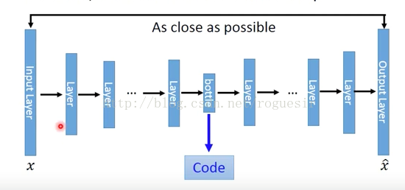
Deep AutoEncoder
每次输出之后，进行误差反向传播，不断优化

Slide 10
Prediction-based
You shall know a word by the company it keeps
0
z₁
1
z₂
The probability for each word as the next word w_{i}
0
……
……
胡锦涛
or
习近平
…
……
“就任国家主席” should have large probability
Training text:
z₂
…… 胡锦涛 就任国家主席 ……
胡锦涛
w_{i-1}
w_{i}
习近平
…… 习近平 就任国家主席 ……
w_{i-1}
w_{i}
z₁
Notes:
A man is known by the company he keeps.
觀其友知其人
Why the word vectors can probably capture the meaning of the words

Slide 11
Prediction-based – Sharing Parameters
0
z₁
1-of-N encoding
of the word w_{i-2}
1
W₁
z₂
The probability for each word as the next word w_{i}
0
……
……
…
z
x_{i-2}
0
The length of x_{i-1} and x_{i-2} are both |V|.
1-of-N encoding
of the word w_{i-1}
W₂
The length of z is |Z|.
1
……
z = W₁ x_{i-2} + W₂ x_{i-1}
0
The weight matrix W₁ and W₂ are both |Z|X|V| matrices.
x_{i-1}
z = W ( x_{i-2} + x_{i-1} )
W₁ = W₂
= W
Notes:
Should I describe it more clearly?
Can consider longer history

Slide 12
Prediction-based – Sharing Parameters
0
z₁
1-of-N encoding
of the word w_{i-2}
1
z₂
The probability for each word as the next word w_{i}
0
……
……
…
0
The weights with the same color should be the same.
1-of-N encoding
of the word w_{i-1}
0
1
……
Or, one word would have two word vectors.
Notes:
通过哈夫曼树等手段减少复杂度O(V)-O(logV)

Slide 13
Prediction-based – Various Architectures
Continuous bag of word (CBOW) model
Skip-gram
w_{i-1}
Neural
Network
…… w_{i-1} ____ w_{i+1} ……
w_{i}
w_{i+1}
predicting the word given its context
…… ____ w_{i} ____ ……
Neural
Network
w_{i-1}
w_{i}
w_{i+1}
predicting the context given a word

Slide 14
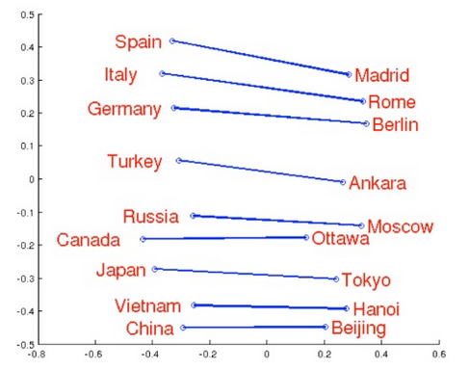
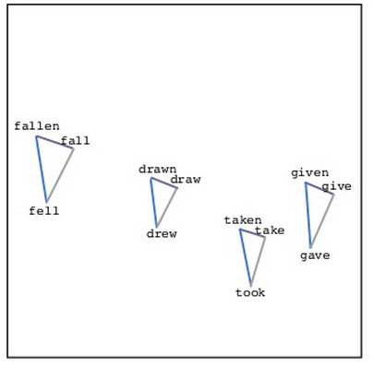
Word Embedding
Source: http://www.slideshare.net/hustwj/cikm-keynotenov2014
Notes:
Why can it happen
How to explain it

Slide 15
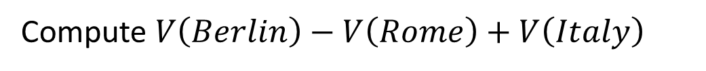
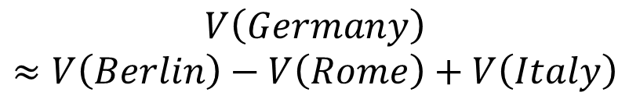
Word Embedding
$$V\left(Germany\right)$$
$$≈V\left(Berlin\right)−V\left(Rome\right)+V\left(Italy\right)$$
Characteristics
Solving analogies
$$V\left(hotter\right)−V\left(hot\right)≈V\left(bigger\right)−V\left(big\right)$$
$$V\left(Rome\right)−V\left(Italy\right)≈V\left(Berlin\right)−V\left(Germany\right)$$
$$V\left(king\right)−V\left(queen\right)≈V\left(uncle\right)−V\left(aunt\right)$$
Rome : Italy = Berlin : ?
Compute $V\left(Berlin\right)−V\left(Rome\right)+V\left(Italy\right)$
Find the word w with the closest V(w)
Notes:
Hierarchy is not mentioned …

Slide 16

Document Embedding
word sequences with different lengths → the vector with the same length
The vector representing the meaning of the word sequence
A word sequence can be a document or a paragraph
…
word sequence
(a document or paragraph)
Notes:
The meaning of word is ambiguous
It can be easy for a document

Slide 17
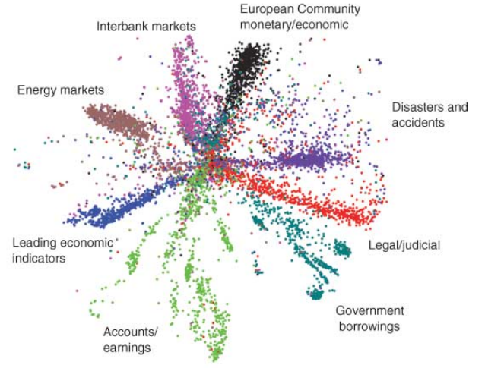
Semantic Embedding
Reference: Hinton, Geoffrey E., and Ruslan R. Salakhutdinov. "Reducing the dimensionality of data with neural networks." Science 313.5786 (2006): 504-507
Bag-of-word
Notes:
Auto-encoder is another approach
The qeruy not always have the common word

Slide 18
Beyond Bag of Word
To understand the meaning of a word sequence, the order of the words can not be ignored.
white blood cells destroying an infection
positive
different
meaning
exactly the same bag-of-word
an infection destroying white blood cells
negative
Notes:
傳染病 infection
http://ezchatbox.ml/
需要找好例子

